Slide 1
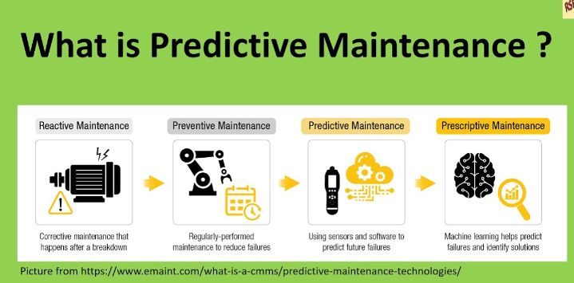
Preventive and Predictive Maintenance Failures
BY: Trisha Winquist
DSC 630 Predictive Analytics

Slide 2
Maintenance Strategies
Ultimately to reduce the current expenses
To keep the plant equipment running on the optimum conditions
To keep the plant operating with a high safety level
Improve the equipment performance against the existing conditions through corrective maintenance
To build up clear and precise data for the vendor qualification, through the maintenance historical data and equipment failure analysis.
The data could be used to help guide any future projects from various vendor quotes

Slide 3
Maintenance Strategies aims to:
Extends machine life
Increase productivity
Lower daily operating costs
Improve system reliability
Decrease the number of maintenance operations, causing a reduction of human errors
Better operations to lower production costs and lower use of resources
As systems become more costly, and instrumentation and information systems tend to become cheaper and more reliable

Slide 4
3 Types of maintenance
Reactive Maintenance – you simply wait until the device fails and then you react to a failure. The problem with this is you may wait for parts to fix the problem. If a loss in a manufacturing facility this could cost many $.
Preventive maintenance- Maintenance before the device fails so there are no disruptions, but you may lose wasted time
Predictive maintenance- Predict and schedule. Minimize downtime and little to no wasted device time. Making intelligent decisions for the future.

Slide 5
This maintenance includes but is not limited to:
Adjustments
Cleaning
Lubrication
Repairs
Replacements
Revamping

Slide 6
Dataset: Source
UC Irvine Machine Learning Repository
2020 Data set- a synthetic dataset that reflects predictive maintenance in the industry
Multivariate, Time-Series with 10000 instances and 14 columns

Slide 7
Dataset: The features
Product ID (Object) consisting of a letter L, M, or H for low (50% of all products), medium (30%), and high (20%) as product quality variants and a variant-specific serial number
Tool Wear(min) (int64) The quality variants H/M/L add 5/3/2 minutes of tool wear to the used tool in the process. and a 'machine failure' label that indicates whether the machine has failed in this particular data point for any of the following failure modes are true.
Air Temperature (K) (float64) generated using a random walk process later normalized to a standard deviation of 2 K around 300 K
Process Temperature (K) (float64) generated using a random walk process normalized to a standard deviation of 1 K, added to the air temperature plus 10 K.
Rotational Speed(rpm) (int64) calculated from the power of 2860 W, overlaid with a normally distributed noise
Torque(Nm) (float) torque values are normally distributed around 40 Nm with an Ïƒ = 10 Nm and no negative values.
Machine Failure (int64) : consists of five independent failure modes
TWF(Tool Wear Failure)
HDF(Heat Dissipation Failure)
PWF (Power Failure)
OSF (Overstrain Failure)
RNF (Random Failures)

Slide 8
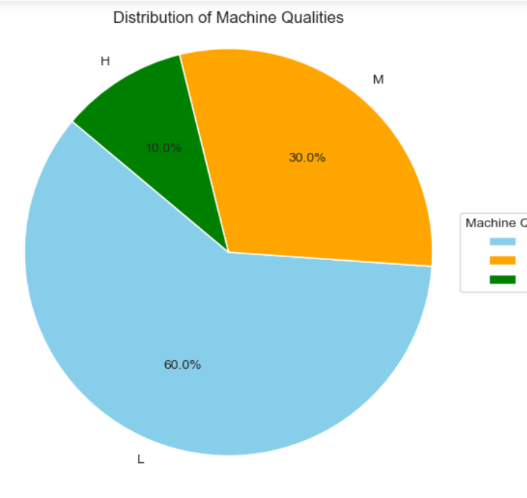
Data Understanding
Failure analysis by machine quality The following pie chart provides insight into the distribution of failures across different qualities of machines. This analysis is crucial to understand if certain machine qualities are more prone to failures, which can be instrumental in predictive maintenance and resource allocation.

Slide 9
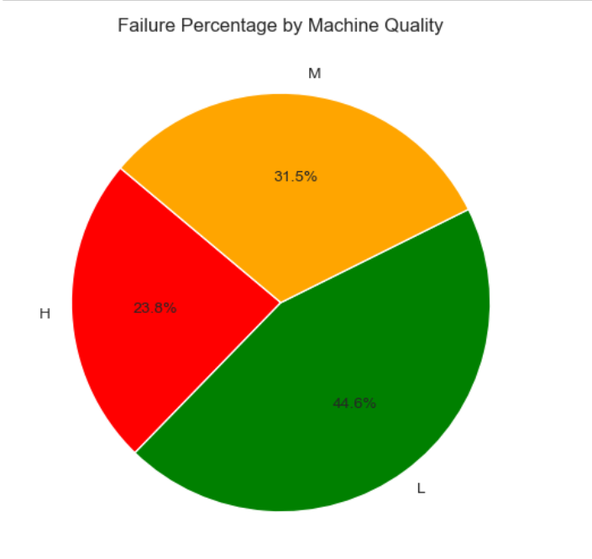
Data Understanding
we can observe that machines of 'Low Quality' are failing at a higher percentage compared to 'High Quality' ones. This could indicate a need for more frequent maintenance schedules or quality checks for the 'Low Quality' machines to prevent downtime. Also, there is not a significant difference between the high and medium quality. From each 100 failure 44.3 comes from low quality, 29.6 comes from medium quality and 26.2 comes from high quality

Slide 10
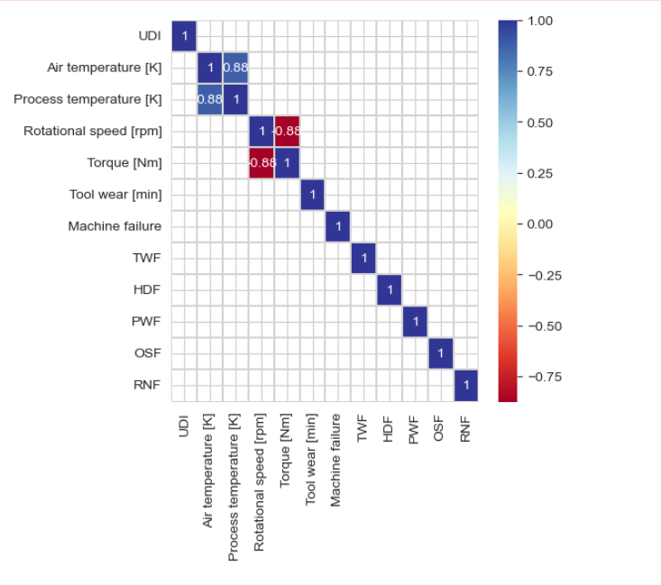
Data Understanding: Machine Failure and TWF Air Temperature and RNF

Slide 11
Methodology: Algorithms
Logistic Regression
Gradient Boosting
Decision Tree Classifier
MPL Classifier
Random Forest

Slide 12
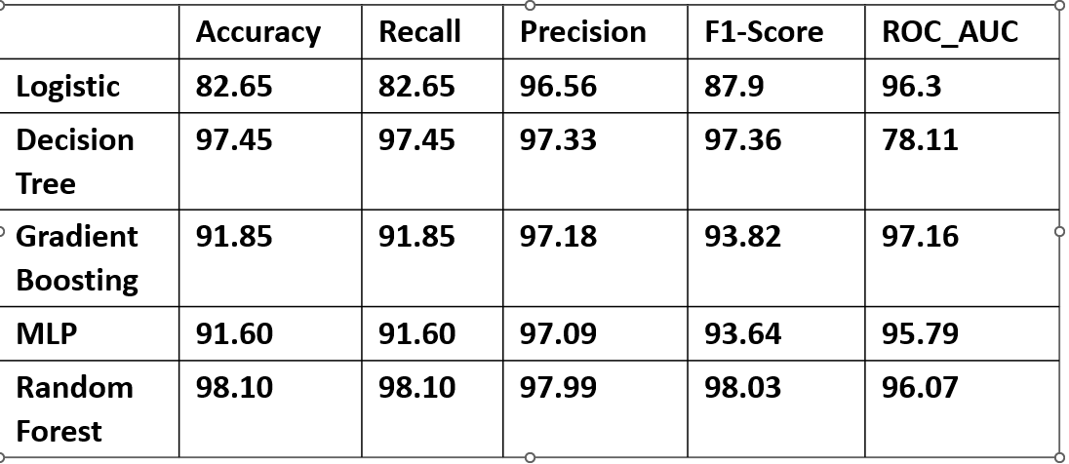
Results Interpretation

Slide 13
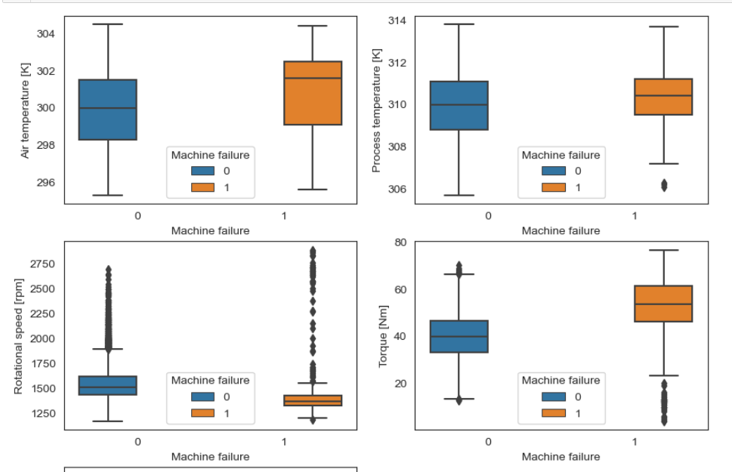
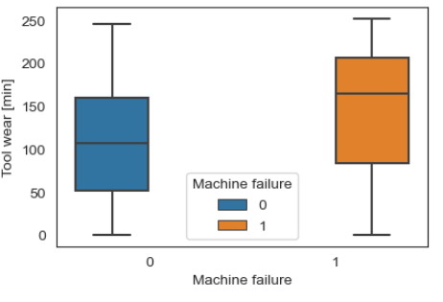
Box and whisper graphs

Slide 14
Conclusion
Random Forest was the most accurate model for predicting Machine Failures
The decision tree was accurate, but the ROC-AUC score was the lowest.
The higher the AUC, the better the model's performance at distinguishing between the positive and negative classes.
The goal was to build a predictive model that can anticipate type of machine failures to minimize downtime and maintenance costs. I think looking at the results has indicated that should be able to answer my question.
The Random Forest model was the most accurate model to predict machine failures.

Slide 15
References:
UCI Machine Learning Repository
https://archive.ics.uci.edu/datasets?search=AI4I%202020%20Predictive%20Maintenance%20Dataset
Kaggle- Predictive Maintenance
Predictive Maintenance: A Deep Dive into the Role of AI and Machine Learning
https://medium.com/@AIreporter/predictive-maintenance-a-deep-dive-into-the-role-of-ai-and-machine-learning-97ab00038449
Getting to know your Data

